Slide 1
Case Studies
Contaminated Land
Sheep-dips & Orchards
Drs. Ben Keet FRSC
Geo & Hydro – K8 Ltd e-mail: ben@benkeet.com

Slide 2
Background Drs Ben Keet FRSC MRSNZ
1st class doctoral in isotope hydrochemistry from Amsterdam University
5 years assistant lecturer physics and groundwater hydraulics and modeling
5 years petroleum engineer and reservoir manager at Shell International
Since 1987 worked on contaminated land projects:
Managed and supervised over 4500 projects
Worked in NZ, Australia, Europe and the US
Specialised in remediation technology, as contractor and consultant
Provided workshops and courses to hundreds of professionals in Holland, Belgium, Australia and New Zealand
Author of handbooks and guidelines on contaminated land
Other studies include low emission emulsion fuels, organic agriculture, chemicals in food and the house and garden environments

Slide 3
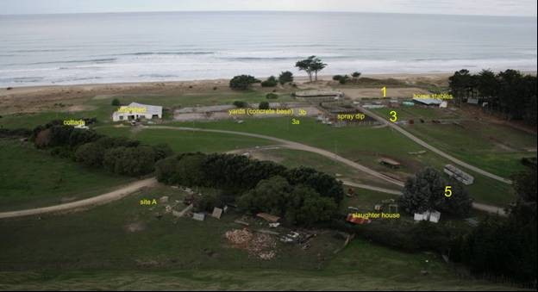
Case: Sheep-dip Assessment
Spray dip
Towards Swim dip

Slide 4
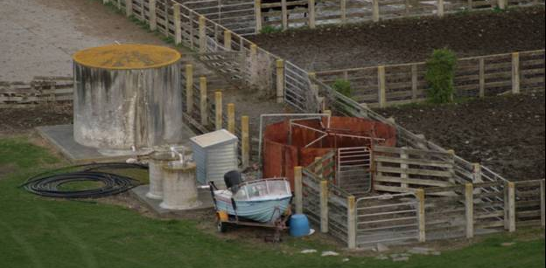
Spray dip

Slide 5
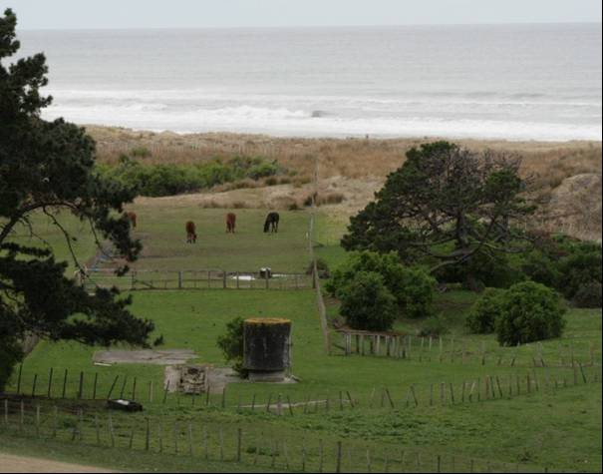
Swim dip
Note the gully, a possible discharge route for sludge from the sheep-dip
This site shows a second option for sludge disposal:
a rack with 3” pipes.
Path leading to woolshed

Slide 6
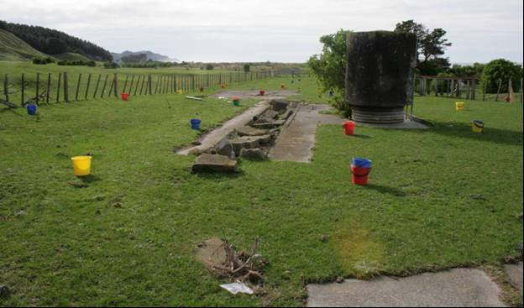
Setting out sample grid

Slide 7
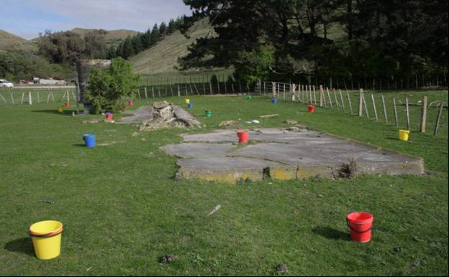
Setting out sample grid

Slide 8
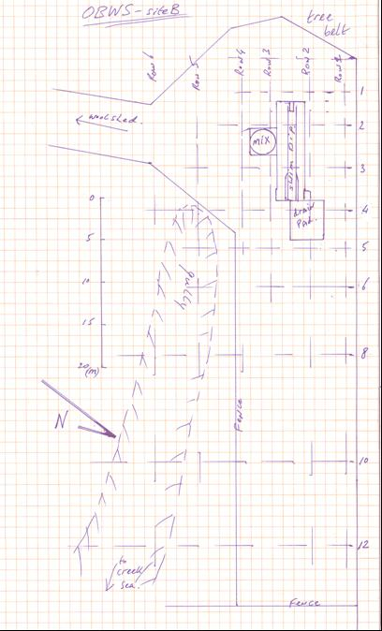
Results
⇦ Row |  |  |  |  |  | Sample Transect ⇨
6 | 5 | 4 | 3 | 2 | 1
 |  | 7 | 9 | 7 | 7 | 1
 |  | 27 | 41 | 78 | 17 | 2
 |  | 189 | 131 | 46 | 36 | 3
 | 20 | 28 | 25 | 35 | 40 | 4
 | 15 | 44 | 19 | 61 | 39 | 5
 | 6 | 57 | 72 | 70 | 33 | 6
6 | 7 | 21 | 45 | 70 | 1 | 8
7 |  | 8 | 38 | 52 |  | 10
6 |  |  | 12 | 98 |  | 12
As in mg/kg w.w.

Slide 9
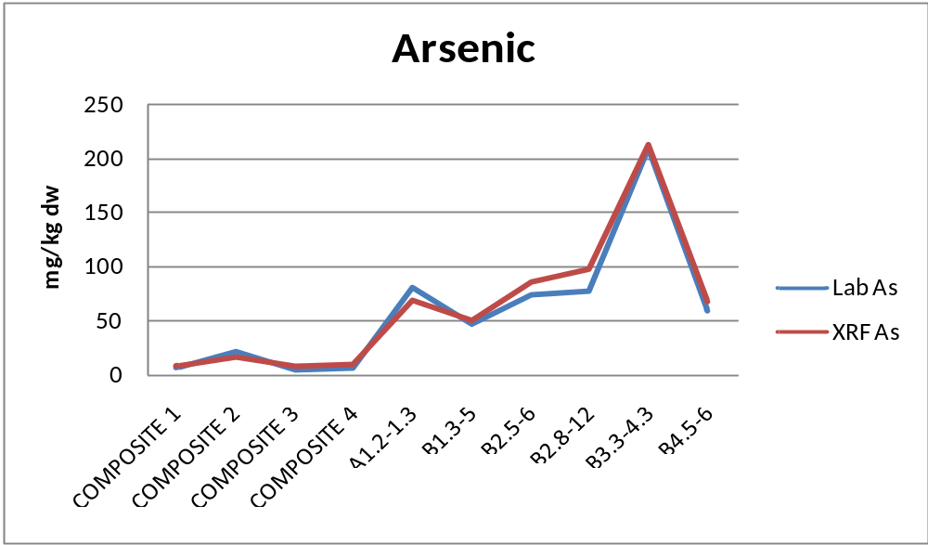
Correlation XRF field analysis with Laboratory analysis
mg/kg d.w.

Slide 10
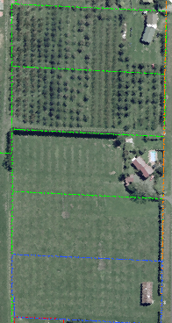
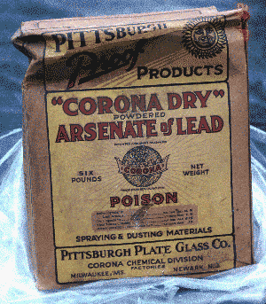
Case: 3 ha Orchard
Hastings, New Zealand
To be subdivided into 34 lots
Main contaminant: Arsenic

Slide 11
Case study objective
Combining field and laboratory analysis gives:
Higher accuracy
Faster decision making
Lower costs
In this case cost is the leading factor choosing sample density

Slide 12
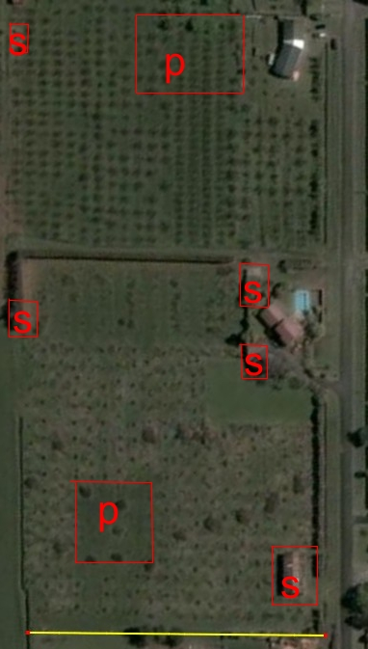
Using historical data and aerial photo’s:
Conceptual Site Model -1
  5 sheds / structures
  2 pear tree blocks
For remediation by soil mixing
Important questions are:
> Where are other ‘hidden’ hotspots?
> What size of hotspot is important?
> How deep are they?
> What volume and concentration?

Slide 13
Environmental Site Assessment (ESA)
Maximum budget ESA $ 30,000.- ex GST.
Initial budget calculation :
Time and mileage etc. $ 1,000.-
Hist. Search, meetings $ 3,000.-
Reporting $ 6,000.-
Sampling objects / hot spots
10 Lab analysis (Metals, OCPNsc) $ 4,000.-
This leaves $ 16,000.- to characterise the ‘diffuse‘ contamination on 3 ha.

Slide 14
Conventional Approach
Cost for data gathering
per sample
Sample taking, COC, courier to lab $ 22.50
Analysis (laboratory) $ 57.50 +
total $ 80.-
For $ 16.000.-
We can get 200 samples taken and analysed
Sampling 2 layers → 100 data points / layer
3 ha/ 100 = 1 data point/ 300 m² (grid size 18x18 m)

Slide 15
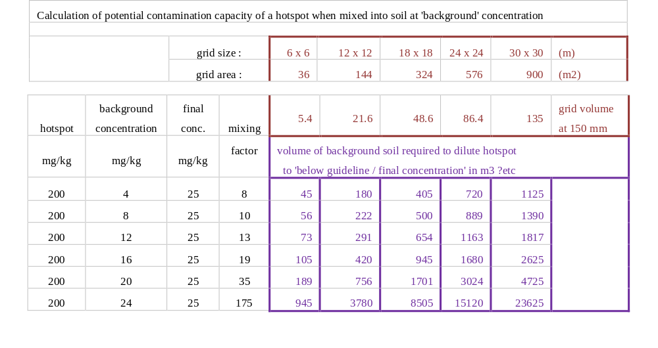
A 18x18 m 200 ppm hotspot requires 945 m³
‘background’ soil to dilute to < 25 mg/kg
945 m³ at 200mm topsoil thickness requires 5000 m²

Slide 16
Conclusion
Conventional sampling – lab analysis
Minimum grid size 18 x 18 m
Undetected hotspots up to 300 m²
Requires about 1000 m³ to dilute
Topsoil of 200 mm: this requires area of 5000 m²
If more than 6 hotspots →
soil mixing will be a failure
Need to identify hot spots more accurately
Extra problem: in parts topsoil on site up to 600 mm thick

Slide 17
Alternative method
Cost for more intense data gathering using on-site XRF analysis
a 2 man site team + XRF costs $ 200.-/hr
Sample 4 layers (0 – 75 – 200 – 400 – 700mm) AND analysing each sample takes 4 minutes / borehole
Cost: $ 13.50 / borehole ( $ 3.50 /sample analysed in the field)
→ 3696 samples were taken and analysed from
924 grid points, reducing grid size to 6 x 6 m – 4 layer, for $ 12,500.-
With $ 3,500.- left over for QA/QC analysis by lab

Slide 18
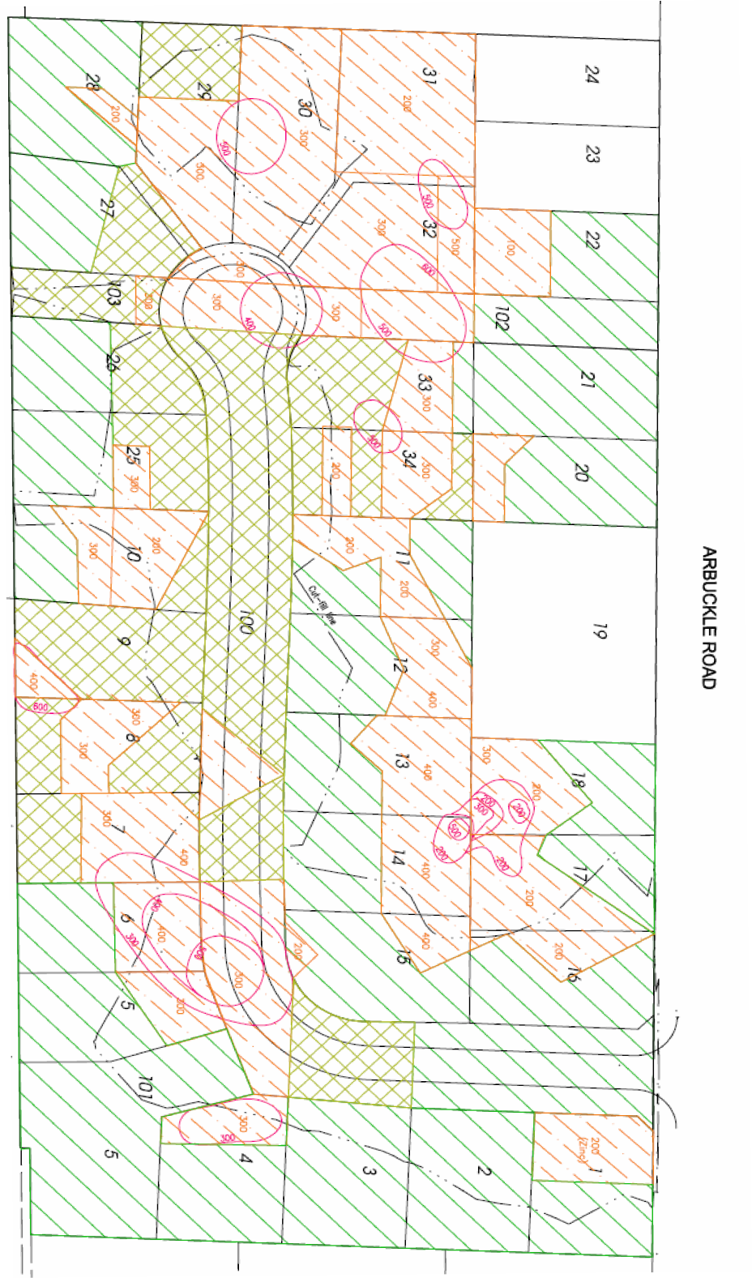
After site assessment with XRF
with 24 boreholes per lot, a total of 912 boreholes, with analysis of 4 layers
Conceptual Site Model 2
Found: 9 hot spot areas
2 associated with ‘objects’
7 not related to objects
Hotspots to depth of 600 mm
Based on hot spot removal BEFORE mixing final As concentration is calculated to become 24 mg/kg
Mixing soil without hotspot removal gives would give As conc. 36 mg/kg, i.e. over the guideline level.

Slide 19
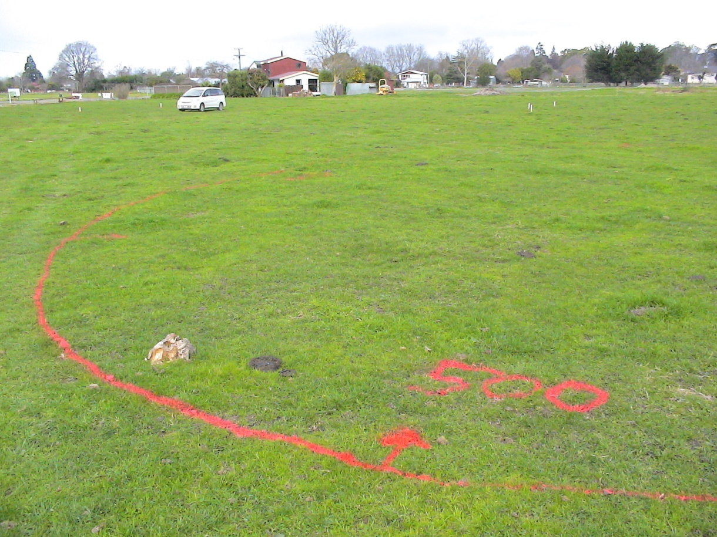
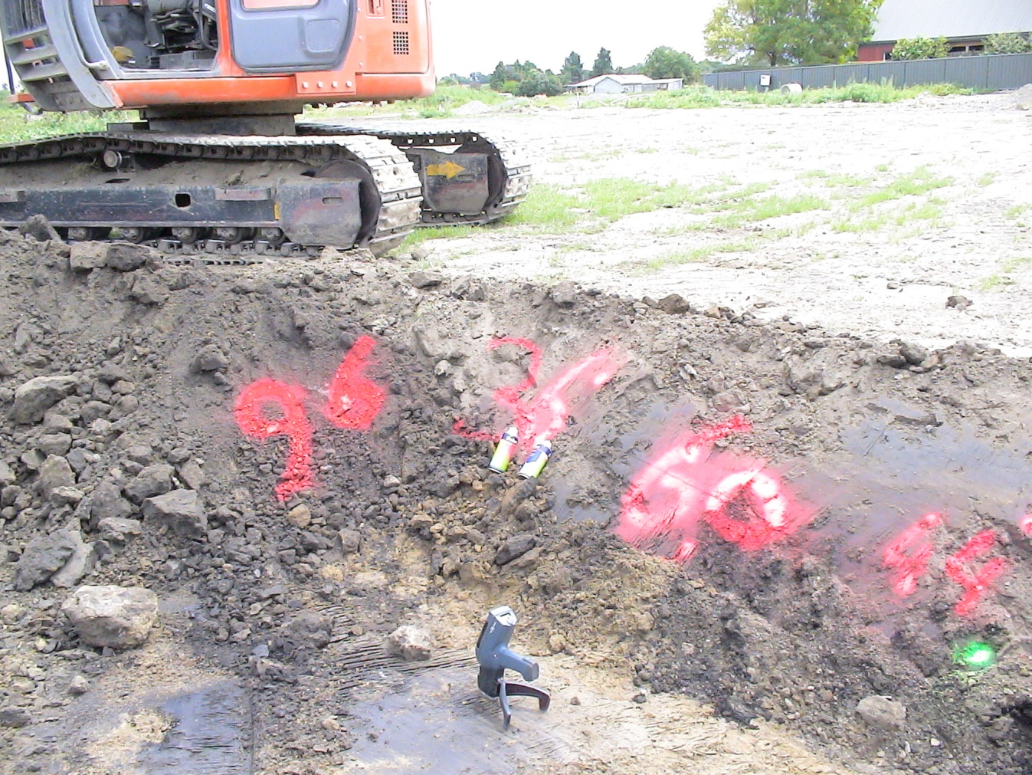
Setting out Hot Spots
With depth to be excavated (mm)
Hot Spot removal
Checking excavations
mark As concentration as means of communication with excavator

Slide 20
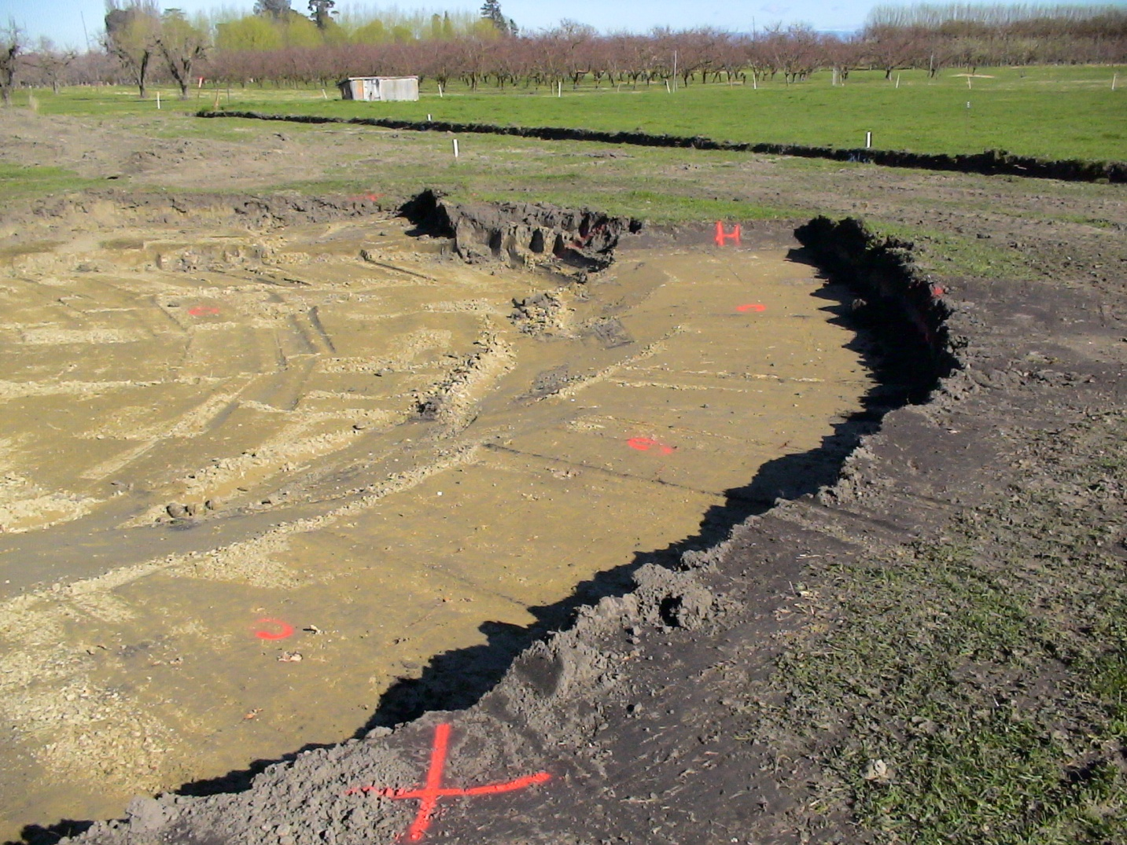
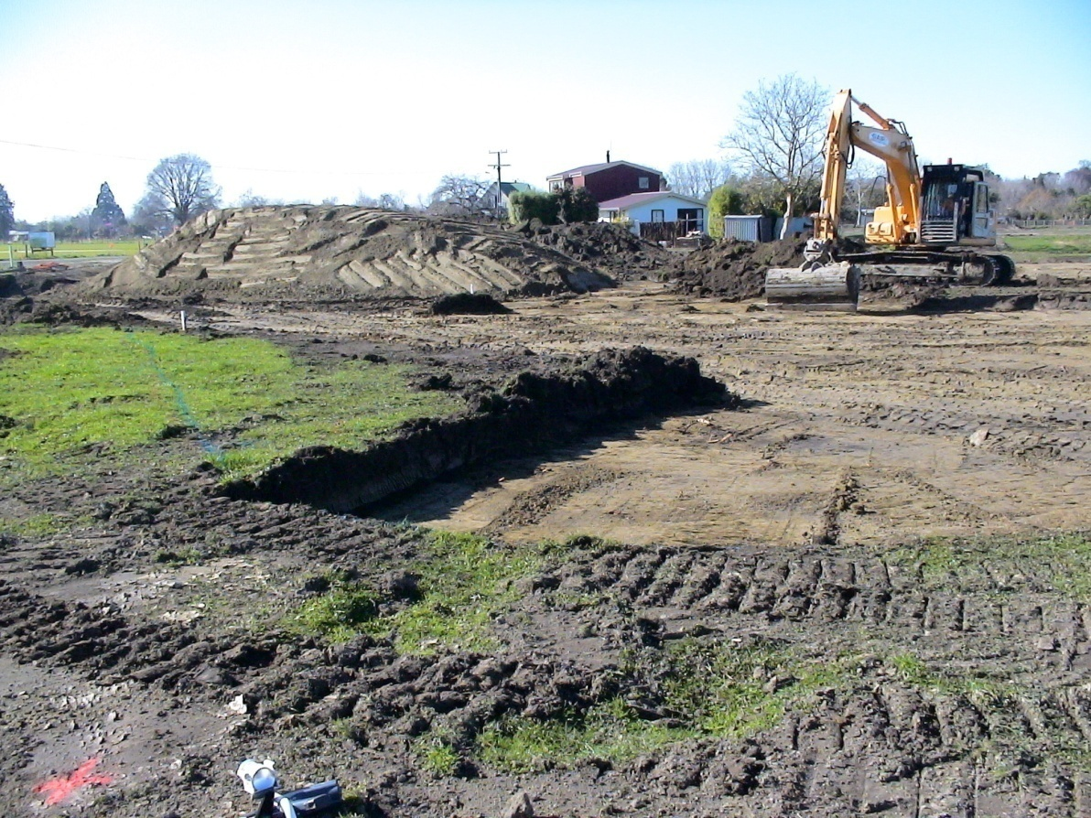
H = “Hot” – bury in Reserve
Cleaning out hot spots
X = OK to MiX
0 = below guideline

Slide 21
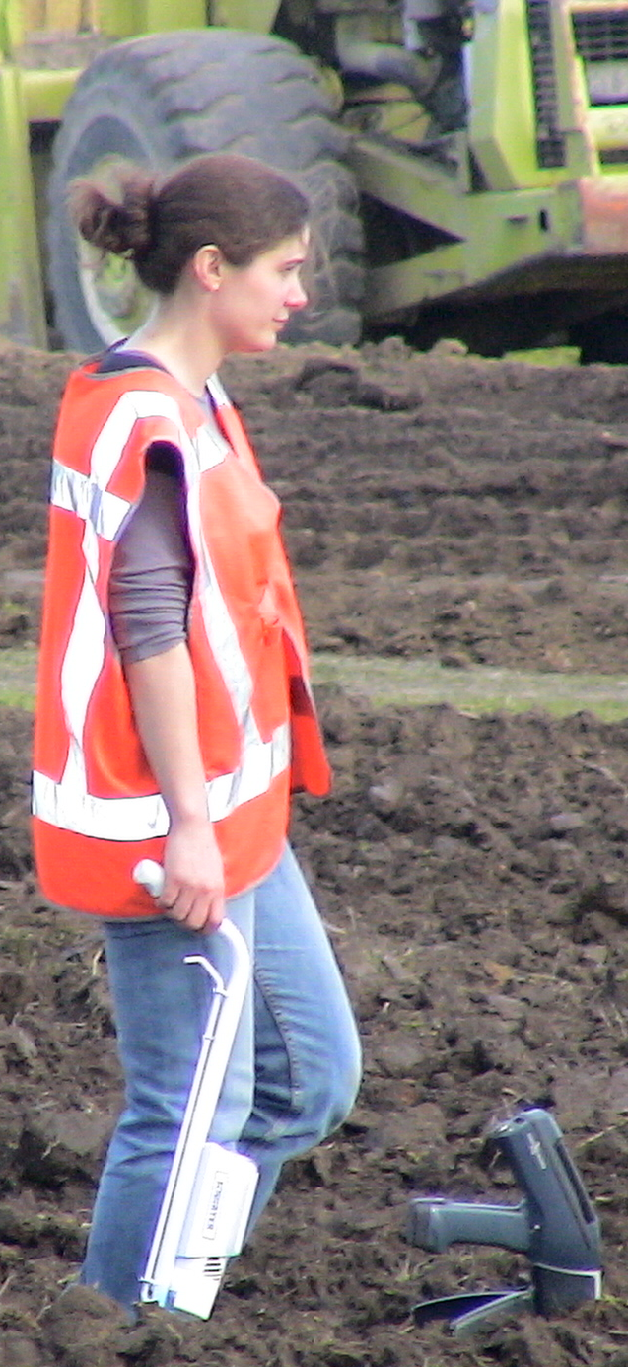
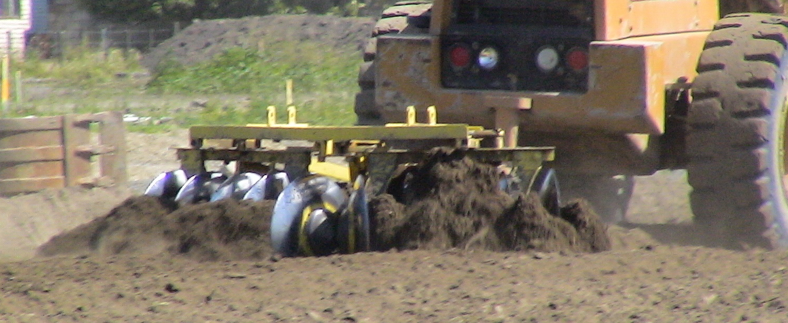
After burial of hot spot soil
in reserves..
all remaining top soil is stripped and laid on a mix pile in 50 mm layers alternating contaminated and clean soil.
Mixing by laying out soil in layers and disking

Slide 22
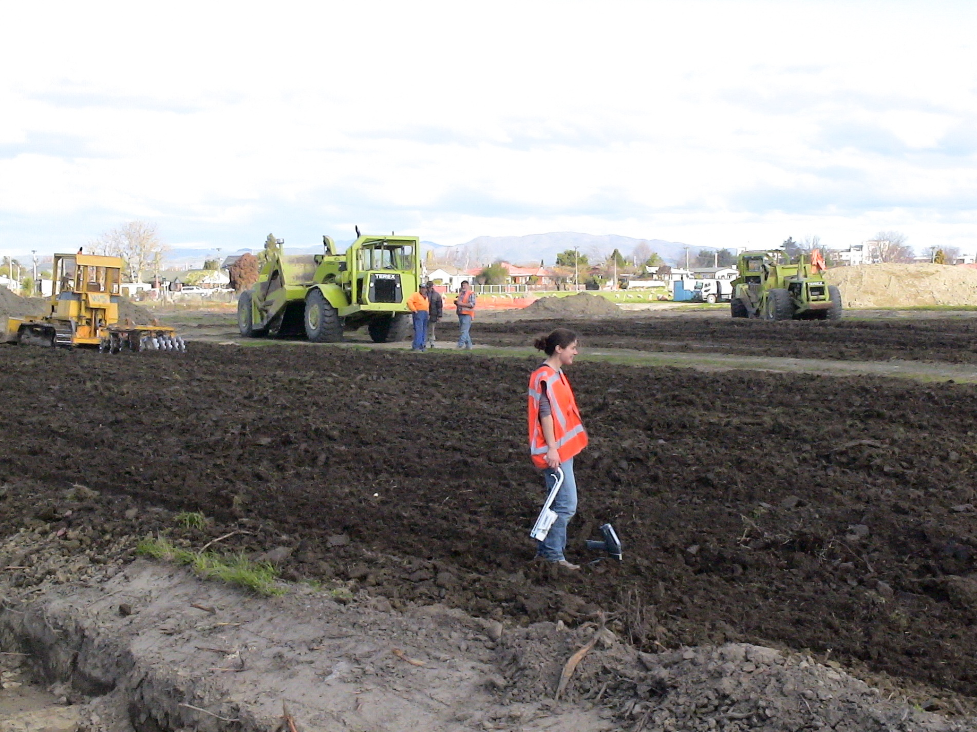
Over 3000 XRF analysis performed during soil mixing

Slide 23
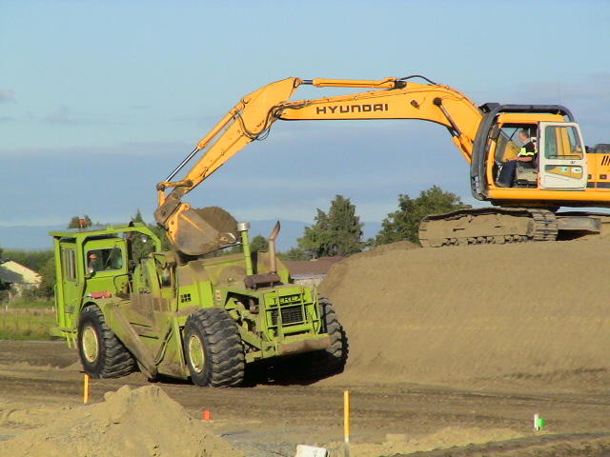
Vertical mixing before final lay-out on sections

Slide 24
Result of XRF checks during remediation
4 more hotspots detected
and separated from mix-pile soil
No hold-up for contractor
All laboratory analysis of soil laid out on sections
had concentrations below guideline levels
No re-mixing required !

Slide 25


Conclusion: Better & Cheaper
Using combined on-site and laboratory analysis results in:
Greatly improved data quality
Very cost effective
Fits perfectly in TRIAD approach
XRF saved a costly re-mix ($ 85,000.-)
Suited to clients who like you to:
“do it right; do it once” & save money !

Slide 26
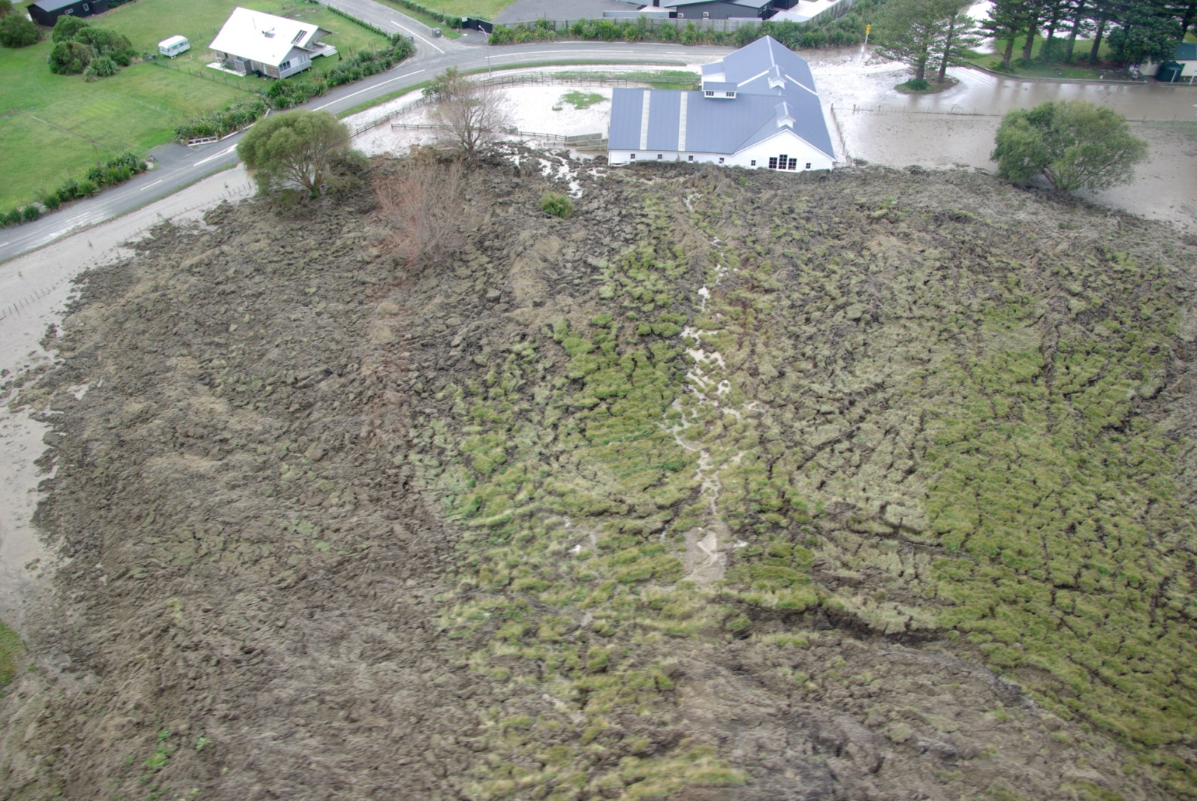
Thank you for your attention
Where did the sheep-dip go
?
Slip at Aramoana woolshed 2011
Questions - Discussion

Slide 27
